Slide 1
BITS Pilani presentation
K. Venkata Ratnam
Mathematics

Slide 2
Course Number : SS ZC416
Course Title: MATHEMATICAL FOUNDATIONS
FOR DATA SCIENCE
Lecture No. :8

Slide 7
Algorithm format

Slide 8
Scaling
It has been observed that if the elements of the coefficient matrix vary greatly in size, then it is likely that large loss of significance errors will be introduced and the propagation of rounding errors will be worse. To avoid this problem, we usually scale the matrix A so that the elements vary less. This is usually done by multiplying the rows and columns by suitable constants.

Slide 9
Row scaling
The multiplication of each Row j by a suitable scaling factor It is done in connection with partial pivoting to get more accurate solutions. Despite much research (see Refs. [E9], [E24] in App. 1) and the proposition of several principles, scaling is still not well understood. As a possibility, one can scale for pivot choice only (not in the calculation, to avoid additional roundoff) and take as first pivot the entry for which is largest; here is an entry of largest absolute value in Row j. Similarly in the further steps of the Gauss elimination.

Slide 10
Operation Count
Quite generally, important factors in judging the quality of a numeric method are:
Amount of storage
Amount of time (=number of operations)
Effect of round-off error
For the Gauss elimination, the operation count for a full matrix (a matrix with relatively many nonzero entries) is as follows.

Slide 11
Operation Count
In Step k we eliminate x_{k} from ‘n-k’ equations. This needs ‘n-k’ divisions in computing the m_{jk} (line 3) and (n - k)(n- k +1) multiplications and as many subtractions (both in line 4).
Since we do n-1 steps, k goes from 1 to n-1 and thus the total number of operations in this forward elimination is

Slide 12
Operation Count

Slide 13
Gauss- Seidel Iteration Method
The Gauss elimination and its variants in the last two sections belong to the direct methods for solving linear systems of equations; these are methods that give solutions after an amount of computation that can be specified in advance.
In contrast, in an indirect or iterative method we start from an approximation to the true solution and, if successful, obtain better and better approximations from a computational cycle repeated as often as may be necessary for achieving a required accuracy, so that the amount of arithmetic depends upon the accuracy required and varies from case to case.

Slide 14
Iteration Method
We apply iterative methods if the convergence is rapid (if matrices have large main diagonal entries, as we shall see), so that we save operations compared to a direct method.
We also use iterative methods if a large system is sparse, that is, has very many zero coefficients, so that one would waste space in storing zeros, for instance, 9995 zeros per equation in a potential problem of 10⁴ equations in 10⁴ unknowns with typically only 5 nonzero terms per equation .

Slide 15
Algorithm (Successive correction)
We assume that a_{jj} =1 (≠0) for j=1,…,n, (Note that this can be achieved if we can rearrange the equations so that no diagonal coefficient is zero; then we may divide each equation by the corresponding diagonal coefficient.) We now write
(1) A = I + L + U
where I is the unit matrix and L and U are, respectively, lower and upper triangular matrices with zero main diagonals.

Slide 16
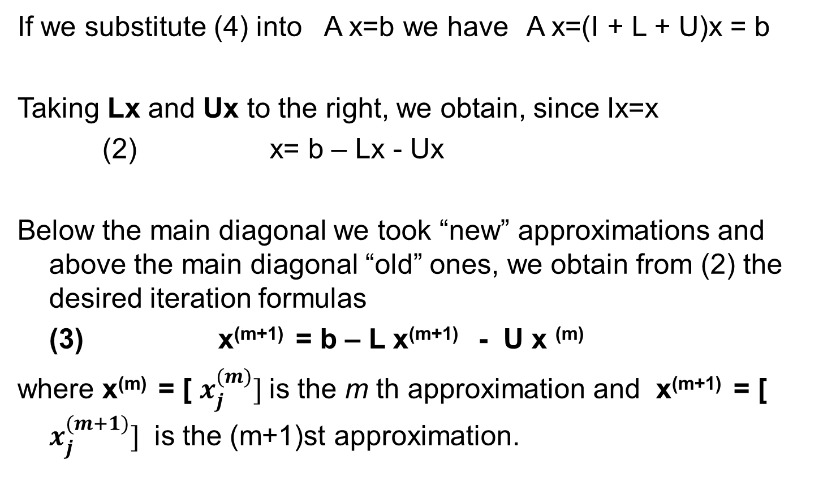
Algorithm
If we substitute (4) into A x=b we have A x=(I + L + U)x = b
Taking Lx and Ux to the right, we obtain, since Ix=x
(2) x= b – Lx - Ux
Below the main diagonal we took “new” approximations and above the main diagonal “old” ones, we obtain from (2) the desired iteration formulas
(3) x^{(m+1)} = b – L x^{(m+1)} - U x ^{(m)}
where x^{(m)} = [ $x_{j}^{(m)}]$is the m th approximation and x^{(m+1)} = [ $x_{j}^{(m+1)}]$ is the (m+1)st approximation.

Slide 17
Convergence and Matrix Norms :
An iteration method for solving Ax=b is said to converge for an initial x⁽⁰⁾ if the corresponding iterative sequence x^{(0),} x^{(1),} x⁽²⁾ ,….converges to a solution of the given system.
Convergence depends on the relation between x^{(m)} and x^{(m+1)}. To get this relation for the Gauss–Seidel method, we use x^{(m+1)} = b – L x^{(m+1)} - U x ^{(m)}. We first have
(I+L) x^{(m+1)} = b-U x ^{(m)}
and by multiplying by (I+L)⁻¹ from the left,

Slide 18
Convergence
x^{(m+1)} = C x ^{(m)} + (I+L)⁻¹ b where C= -(I+L)⁻¹ U
The Gauss–Seidel iteration converges for every x ⁽⁰⁾ if and only if all the eigenvalues of the “iteration matrix” C have absolute value less than 1.

Slide 19
Algorithm

Slide 20
Convergence

Slide 21
Solve the problem using gauss seidel iteration using the starting the starting value x₀ = [1 1 1].
4x₁ - x₂ =21
-X₁ + 4 x₂ -x₃ =-45
-x₂ + 4x₃ =33

Slide 23
Example

Slide 24
Jacobi Iteration.
The Gauss–Seidel iteration is a method of successive corrections because for each component we successively replace an approximation of a component by a corresponding new approximation as soon as the latter has been computed.
An iteration method is called a method of simultaneous corrections if no component of an approximation is used until all the components of have been computed. A method of this type is the Jacobi iteration, which is similar to the Gauss–Seidel iteration but involves not using improved values until a step has been completed and then replacing x^{(m)} by x^{(m+1)} at once, directly before the beginning of the next step.

Slide 25
Hence if we write A x=b (with a_{jj} =1 as before!) in the form
x = b + (I - A)x
the Jacobi iteration in matrix notation is
x^{(m+1)} = b + (I - A) x^{(m)}
This method converges for every choice of x⁽⁰⁾ if and only if the spectral radius of (I - A) is less than 1. It has recently gained greater practical interest since on parallel processors all n equations can be solved simultaneously at each iteration step.

Slide 26
Problem
Solve the problem using gauss seidel iteration using the starting the starting value x₀ = [1 1 1].
4x₁ - x₂ =21
-X₁ + 4 x₂ -x₃ =-45
-x₂ + 4x₃ =33

Slide 28
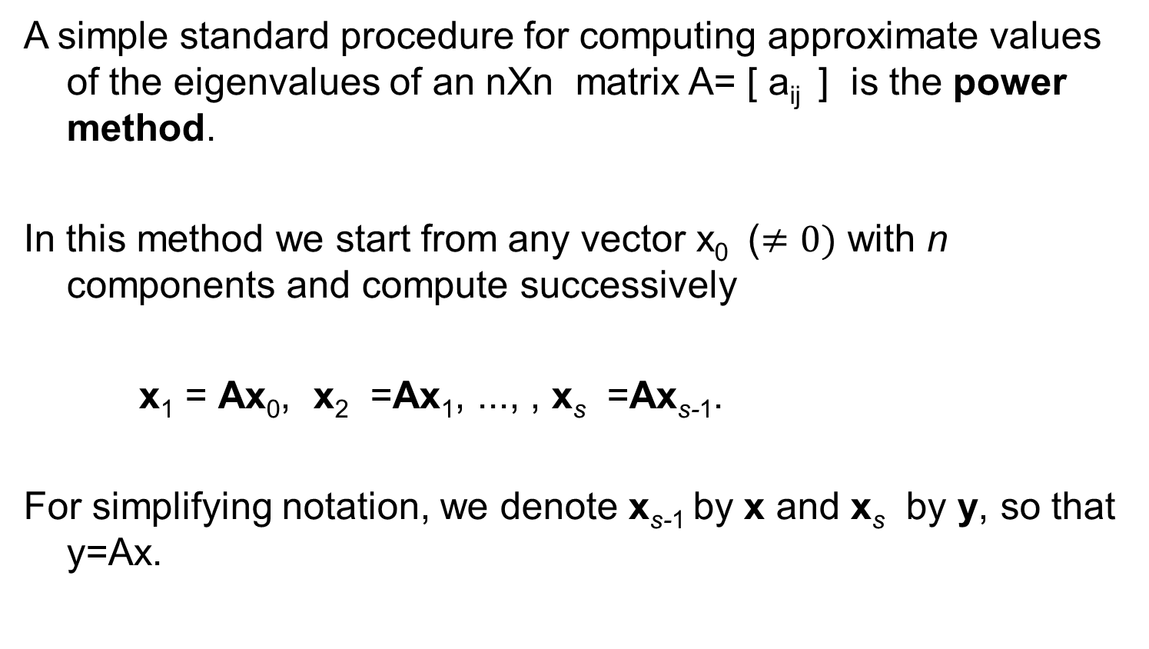
Power Method for Eigen values
A simple standard procedure for computing approximate values of the eigenvalues of an nXn matrix A= [ a_{ij} ] is the power method.
In this method we start from any vector x₀ ($≠0)$ with n components and compute successively
x₁ = Ax₀, x₂ =Ax₁, ..., , x_{s} =Ax_{s-1}.
For simplifying notation, we denote x_{s-1} by x and x_{s} by y, so that y=Ax.

Slide 29

Power method
The method applies to any nXn matrix A that has a dominant eigenvalue (a $λ$such that | $λ$| is greater than the absolute values of the other eigenvalues). If A is symmetric, it also gives the error bound (2), in addition to the approximation (1).

Slide 30
Theorem

Slide 31
Power method
The main advantage of the method is its simplicity. And it can handle sparse matrices too large to store as a full square array. Its disadvantage is its possibly slow convergence.
From the proof of Theorem 1 we see that the speed of convergence depends on the ratio of the dominant eigenvalue to the next in absolute value.
If we want a convergent sequence of eigenvectors, then at the beginning of each step we scale the vector, say, by dividing its components by an absolutely largest one.

Slide 32

Problem
Apply power method without scaling (3 steps ) using x₀ =[1 1 1]. Give Rayleigh quotients and error bounds for the matrix:
$$\left(\begin{matrix}4 & 2 & 3 \\ 2 & 7 & 6 \\ 3 & 6 & 4\end{matrix}\right)$$

Slide 33
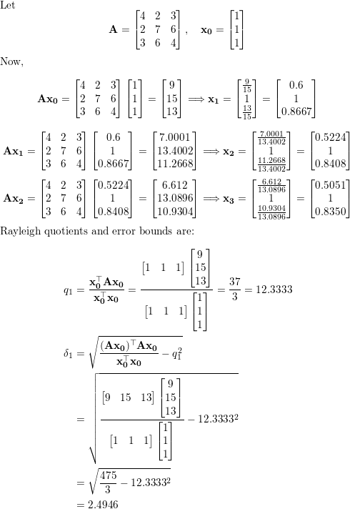
Sol

Slide 34
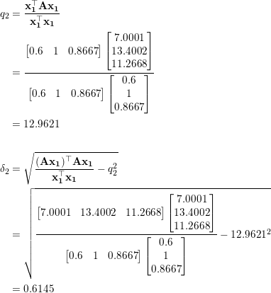
Sol

Slide 35
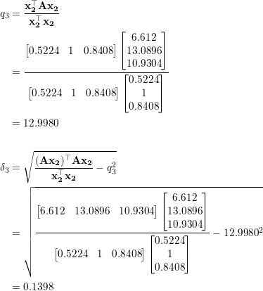
Sol

